Slide 1
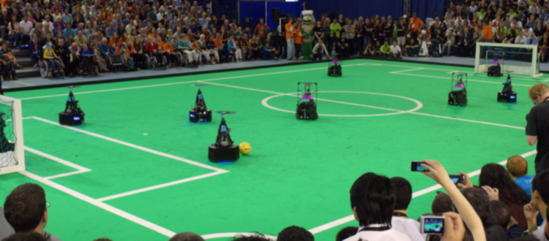
Stakeholder meeting- AutoRef
16/02/2024
Quinten Swaan, Project Manager
Department of Mathematics and Computer Science, EngD. Mechatronic Systems Design

Slide 2
Goal of meeting
To discuss and agree on the scope of the project

Slide 3
Agenda
Work previous 2 weeks
Project management plan
Project scope
Planning meetings
Summary
11:00 – 11:05
11:05 – 11:10
11:10 – 11:50
11:50 – 11:55
11:55 – 12:00

Slide 4
Previous weeks
Summarized work previous years
Literature review
Project management plan
Studied MSL rules
Contacted and interviewed TechUnited
Decision trade-off matrix and stories
Most important features
User needs
Project scope

Slide 5
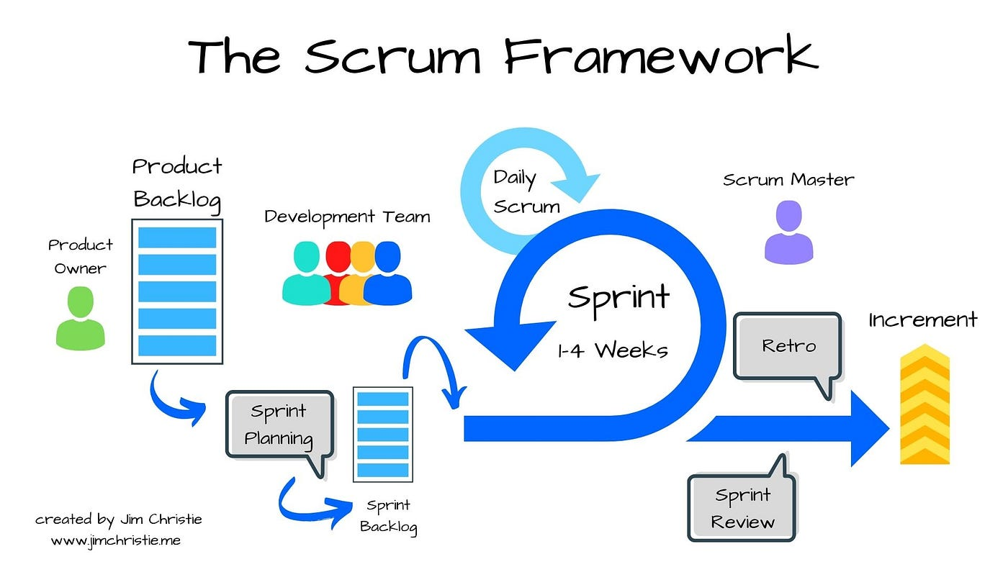



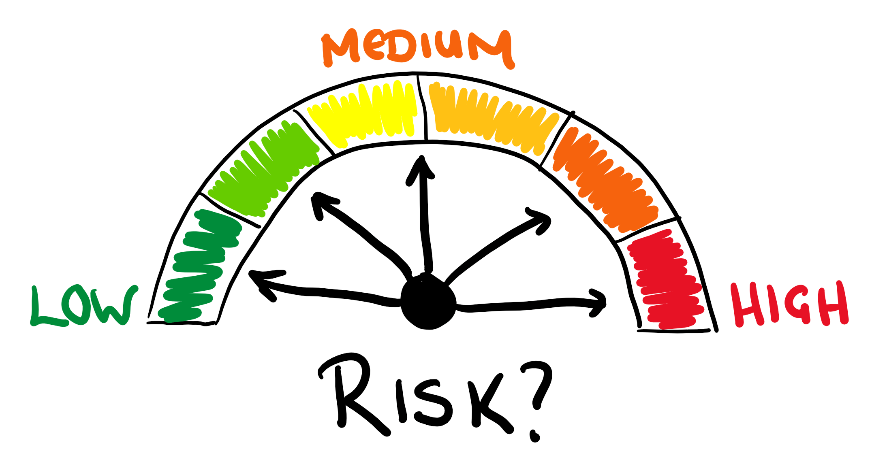

Project management plan

Slide 6
Project direction
Mission: “To observe the match and make autonomous, unbiased decisions based on the soccer robot rules that can be communicated to teams and viewers. ”
2022
Future
Object detection
1 rule
Fully Autonomous
TURTLE data
2 rules
?
2021
2023

Slide 7
User needs
Robustness
Adaptability
Progress
Performance
Continuity
Accurate
Real-time
Follow RoboCup MSL rules
Objectivity
Consistent decisions
Showing proof
Safety
Communication
Sending decisions

Slide 8
New functionality
RC-12.3.4 & RC-12.3.5. Illegal Defense & Attack. Max 1 player in penalty area for 10s.
Not yet implemented → Progress
Hard for human referees → Objectivity
Easy to implement
Who touched the ball last time for the award of FL-15, FL-16, FL-17.
Not yet implemented → Progress
Very common rule
Send decisions to RefBox → Communication
Not yet implemented → Progress
For a complete system we need tracking, rules and communication
Notes:
Deniz?

Slide 9
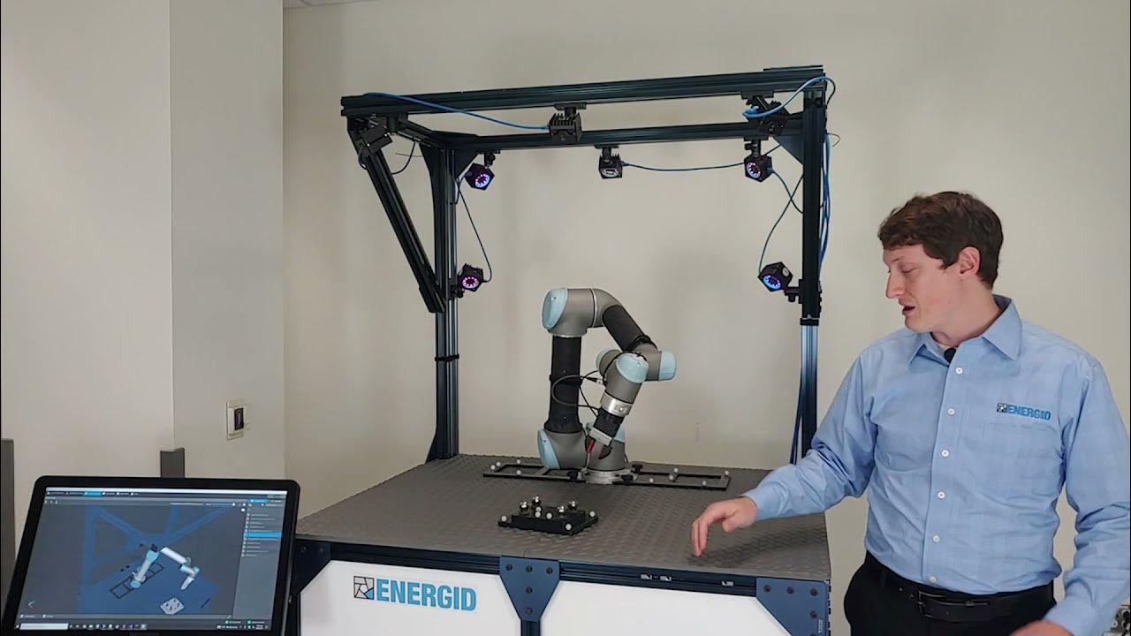
Method
OptiTrack
Sub mm accuracy w.r.t. field → Performance
Implemented by TechUnited → Progress
Quick start at TechUnited → Progress
Multiple camera’s (12) → Objectivity
Output is pose of object → Continuity
Easy integration with MATLAB and ROS
Drawbacks:
Expensive
Difficult to setup somewhere else
Can not be used outdoors
Markers on robots and ball

Slide 10
Project Planning
Project scope:
Enforce rules RC-12.3.4 & RC-12.3.5
Who touched the ball last time for FL-15, FL-16 and FL-17
Using OptiTrack data
Sending decisions to RefBox
Planning for the next sprint:
Get pose data from OptiTrack
Use pose data from OptiTrack to enforce rules RC-12.3.4 & RC-12.3.5
Create product backlog
Assess risks

Slide 11
Planning meetings
Recurring meetings Friday 14:00 – 15:00
Availability?

Slide 12
Summary

